Slide 1
BROWTASTIC
Reason for choice of domain
I chose this domain because it’s my personal business and I want to see it grow into something bigger, I handle everything- bookings, payments, client's record, and making sure my service stays top tier. To keep things running smoothly, I need a system that organizes client information, tracks appointments, manage payments, and keeps inventory. Having everything structured will not only make my life easier but also help improve client experience, keep things professional, and scale my business the way I envision.
A summary of the data the model should hold
Browtastic is a semi-permanent makeup business specializing in microblading, ombre brows, micro-shading and related services.
Customers should be able to book appointments, reschedule, or cancel appointments.
Each appointment links to a procedure and may require a touch-up
Payments are recorded for appointments, contributing to sales tracking.
Notifications remind customers of bookings, and seasonal discounts may apply to services.
Customers can leave reviews/feedback after procedure.

Slide 2
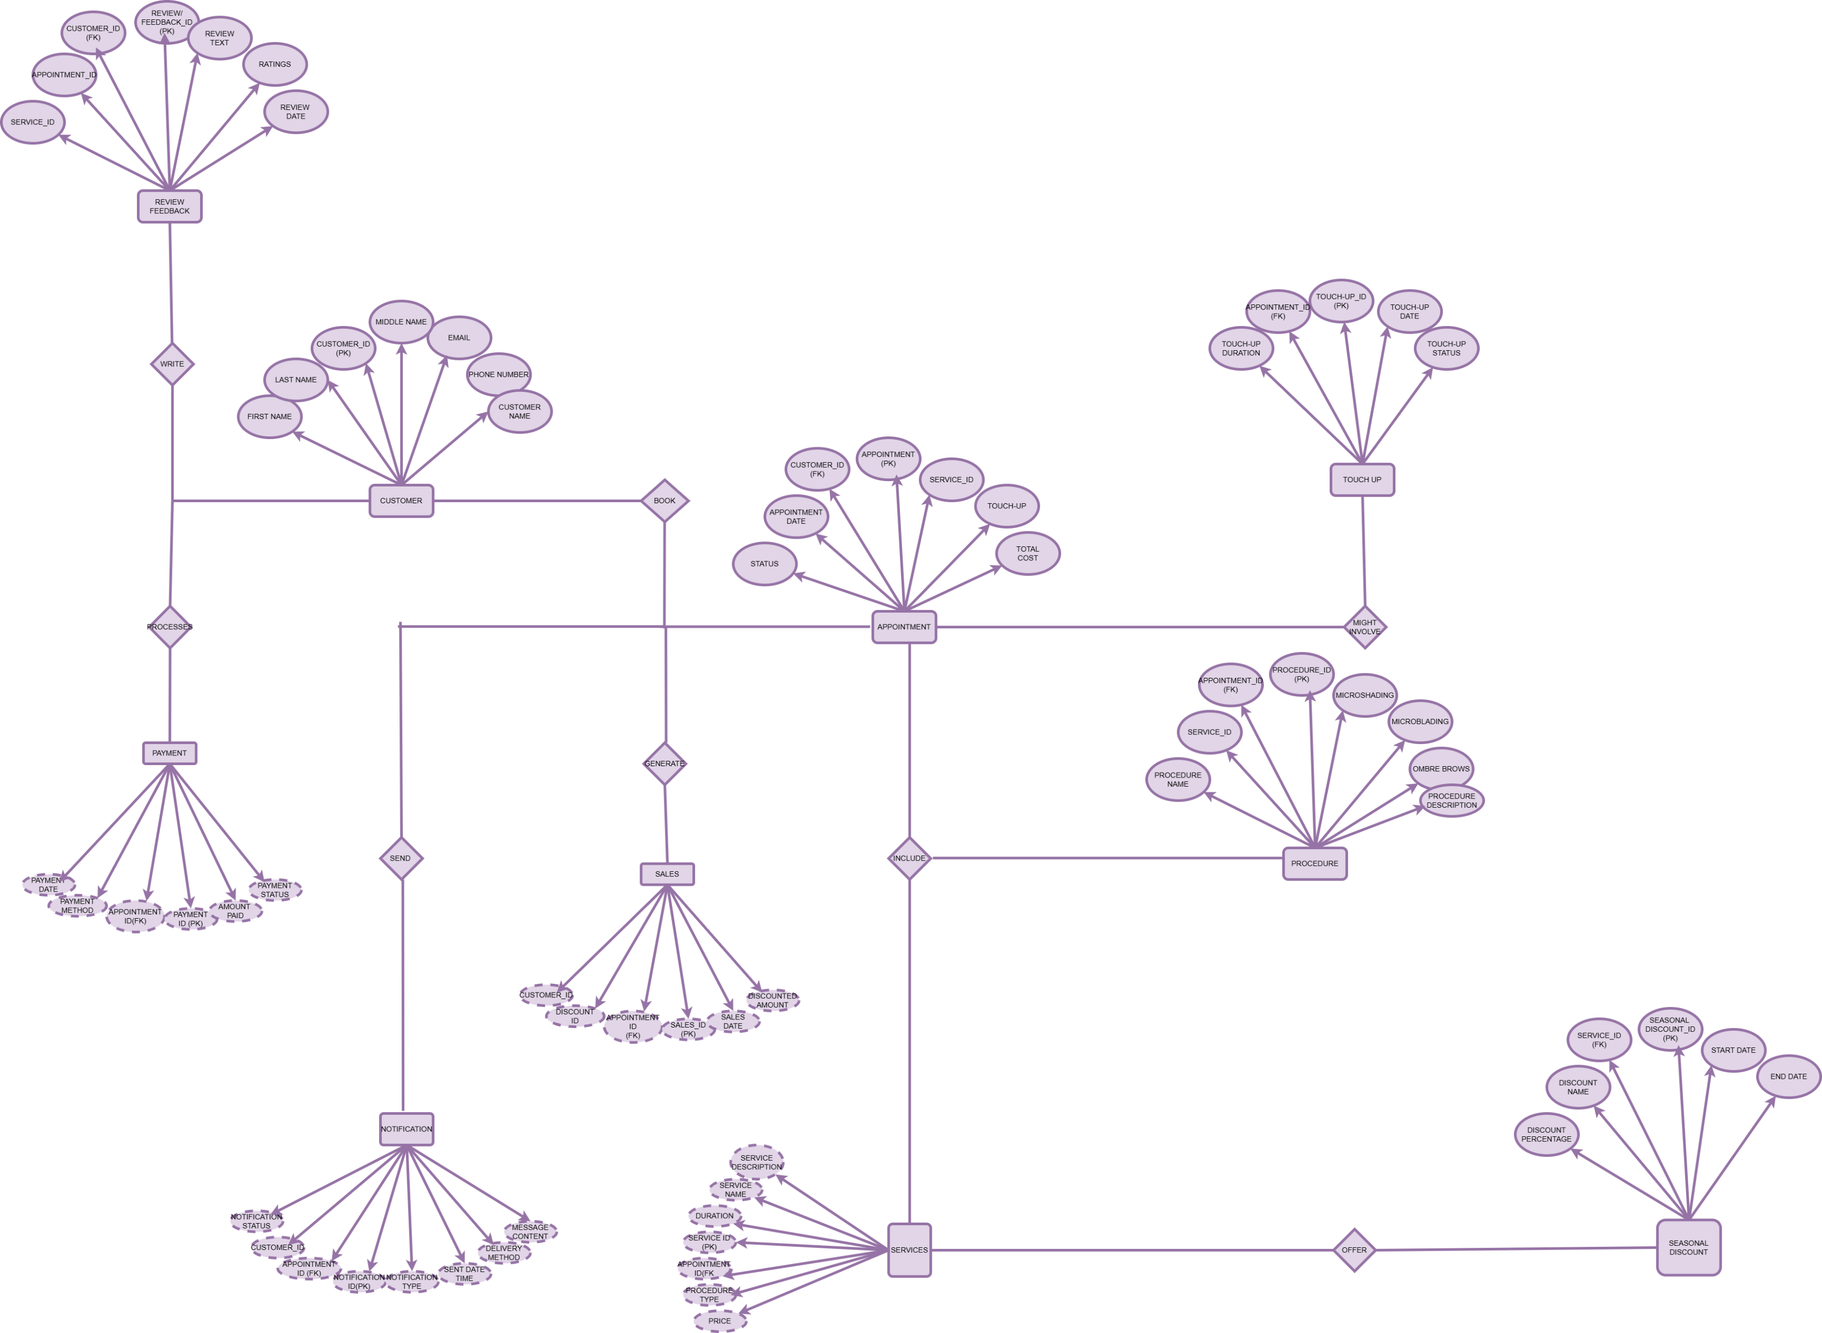

Slide 3
Entities
Customer
Appointment
Services
Feedback/reviews
Sales
Payment
Touch-up
Seasonal discounts

Slide 4
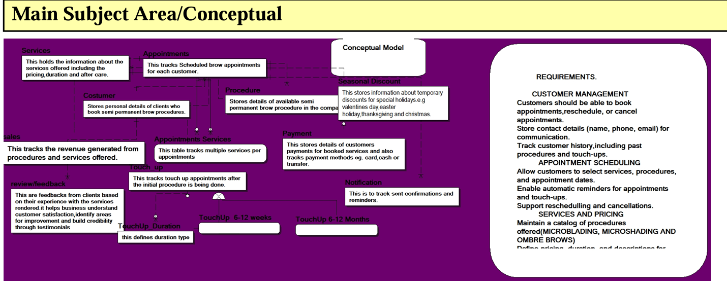

Slide 5
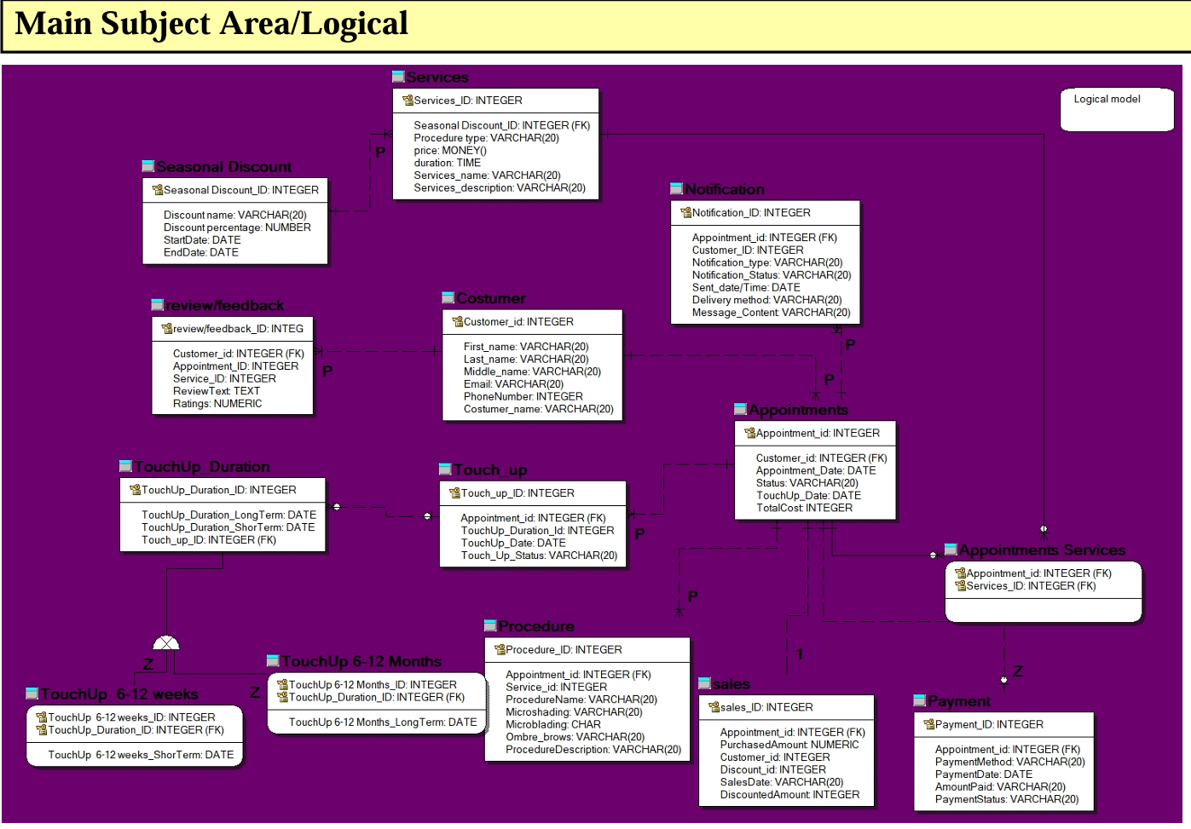

Slide 6
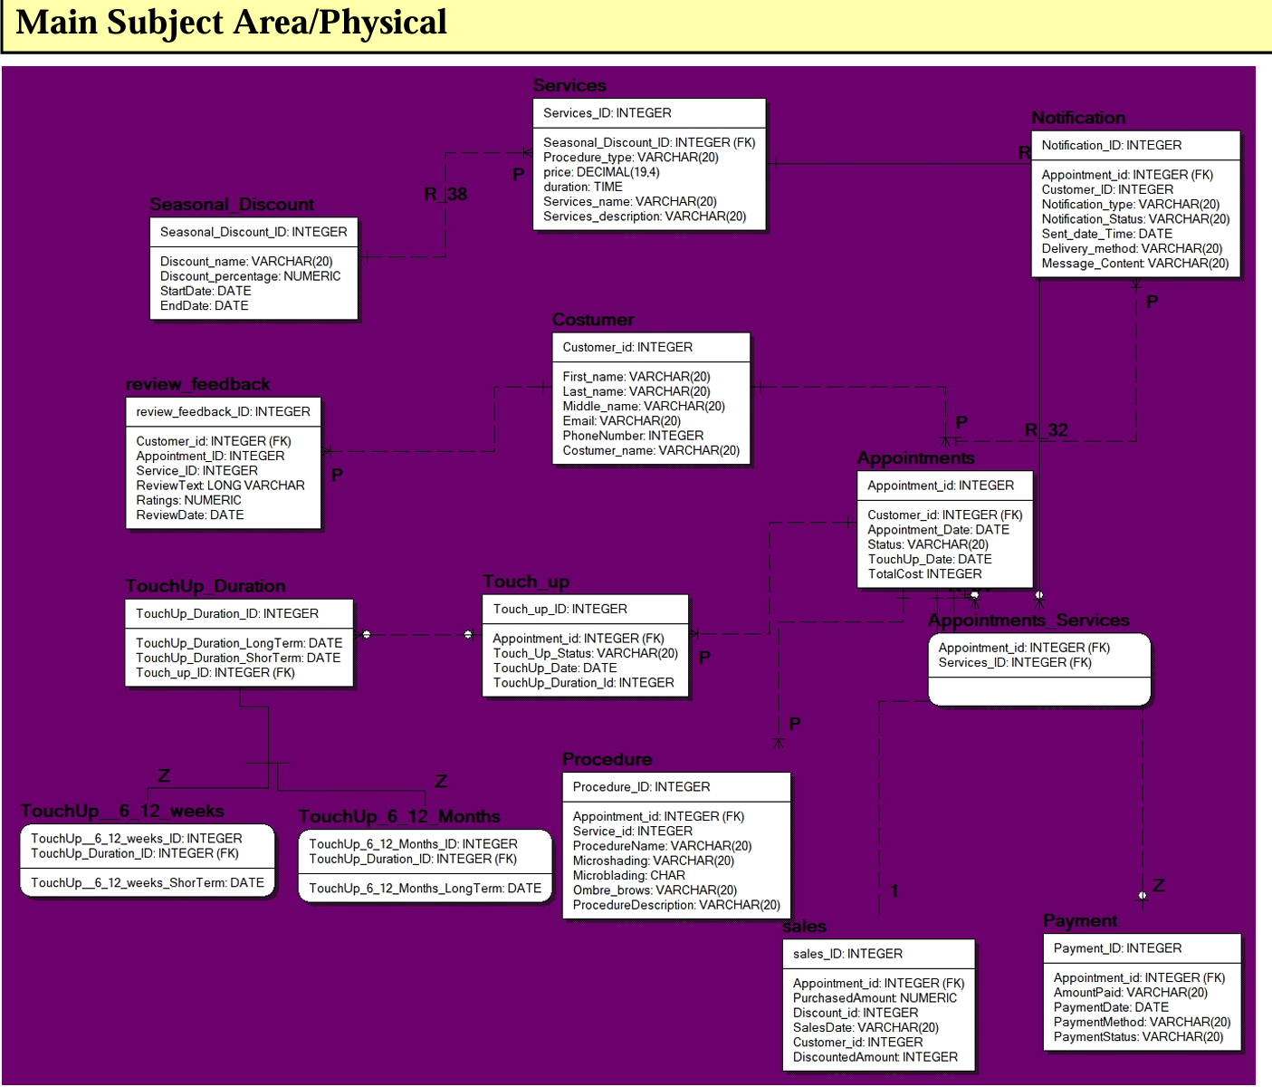

Slide 7
Relationships
Customer to Appointment (ONE-TO-MANY)
A customer can have multiple appointments, but each appointment belongs to only one customer.
Appointment to Service (ONE TO MANY)
An appointment can include multiple services, such as microblading and shading in one service.
Customer to reviews (ONE TO MANY)
A customer can leave multiple reviews, each tied to a different appointment or service.
Seasonal Discount to services (ONE TO MANY)
A discount can apply to multiple services, but each service can have only one active discount at a time.
Appointment to services (MANY TO MANY)
An appointment can have many services, and a service can be part of many appointments.
Appointment to sales (one to one)
One appointment generates one sales record.
Appointment to touch up (one to many)
A customer may need a follow up session and each is recorded separately, but each touch-up is linked back to the original appointment.

Slide 8
PRIMARY KEY
Customer Id (customer table) - uniquely identifies each customer.
Appointment Id (appointment table) - ensures each appointment is distinct.
Service Id (service table) - differentiates each service offered.
Payment Id (payment table) - tracks individual transactions.
Sales Id (sales id) – ensures each sales record is unique.
Touch-up Id (touch up table) - uniquely identifies each touch-up session.
Discount Id (seasonal discount table) – uniquely identifies discount campaigns.
FOREIGN KEY
Customer Id (appointments table) – links appointments to specific customers.
Appointment Id (payments table) – ensures each payment corresponds to an appointment.
Service Id (appointments service join table) – connects appointment to selected services.
Appointment Id (touch up table) – links a touch-up session to the original appointment.
Discount Id (service table) – associates a service with a seasonal discount, if applicable.

Slide 9
Design decision
Join table for appointment and services- Avoided self-join by using an appointment_service table to handle the many to many relationship.
Separate touch-up-table – since touch-ups aren’t always needed, they were kept separate but linked to the original appointment.
Discounts linked to services – Ensured seasonal discounts apply per service, not per appointment, for better flexibility.
Payments linked to appointments – Each payment corresponds to a specific appointment, making financial tracking easy.
Challenges
Self-join issue – fixed by using a join table for appointments and services
Managing optional touch-ups – kept them in a separate table to avoid unnecessary null values.
Applying discounts correctly – linked them to services instead of appointments for automatic application.
Managing payment and sales – separated payments from sales to allow for deposits and multiple transactions per appointment.
This design ensures data integrity, flexibility and efficient tracking.

Slide 10
Enhancing performance
Since this database is already in use for my business, the focus is on improving performance and keeping efficiency. Indexes are applied to frequently searched fields like client ID and appointment ID to speed queries and enhance responsiveness. Foreign key constraints ensure data integrity by linking bookings, payments and services. As the business grows, the database will manage more appointments and transactions, which could slow down performance. To prevent this, large tables may be partitioned based on criteria like dates (e.g. grouping appointments by month or year) to improve search efficiency. Additionally regular backups and security measures would be in place to protect sensitive client and payment information.

